Slide 1
KBC GAME
Submitted in the partial fulfillment for the award of the degree of
BACHELOR OF ENGINEERING
IN
INTERNET_OF_THINGS
Submitted by:
AMAYRA_20BCS4544
ANSHUMAAN SANJAY_20BCS4545
NEHA SHARMA _20BCS4576
Under the Supervision of:
HARMANDEEP KAUR JHAJJ
Department of AIT-CSE
DISCOVER . LEARN . EMPOWER

Slide 2
Outline
Introduction to Project
Problem Formulation
Objectives of the work
Methodology used
Results and Outputs
Conclusion
Future Scope
References

Slide 3
Introduction to Project
Kaun Banega Crorepati (KBC) simulation system is based on the television show by the same name, hosted by Mr. Amitabh Bachchan.
The main objective of this application is to provide its users with an opportunity to play the famous quizzing game at the comfort of their homes on a computer system.
The main purpose of this game is to make people learn new things and improve their general knowledge, just by playing a game

Slide 4
Problem Formulation
Observing the above mentioned literature survey , it's miles found that research spotlight the want of green and scalable technique for e-studying useful resource and evaluation approach being one of the maximum critical aspect. The current strategies are normally described to 1 or fields ,so we want a easy to apply flexible machine that may be green in evaluation throughout diverse topics in a single go.

Slide 5
Objectives
The main objective of C++ project on KBC system is to Manage the
details Patterns, Participants, Level, Points, Questions. It manages all
the information about the Game. The project is totally built at
administrative end and thus Only the administrator is guaranteed the
access. The Purpose of the project is to built an application program to
reduce the manual work for managing the patterns, Participants, Answers.
And this project is to make people learn new things and improve their
general knowledge.

Slide 6
Methodology used
Create a page were users enter their name age and place they belong.
• Their details and rules of KBC GAME will be displayed on c++ compiler screen.
• Question will be displayed on screen and user have to choose one correct answer .
• For using life-line user need to press L.
• If you give the right answer you will win the respective amount else you will lose the game..

Slide 7
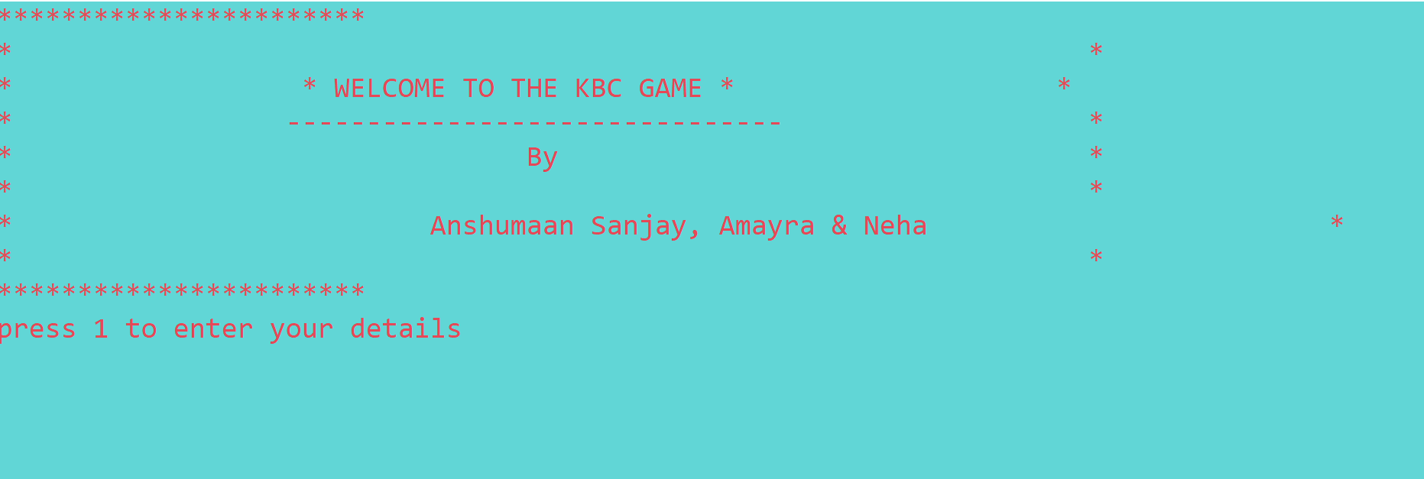
Results and Outputs

Slide 8
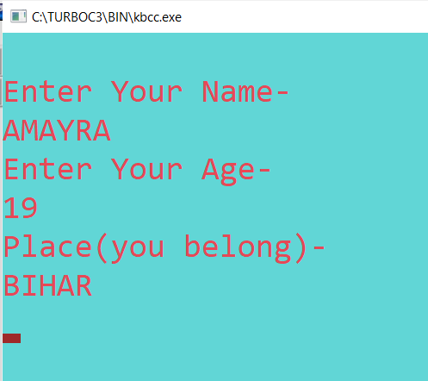
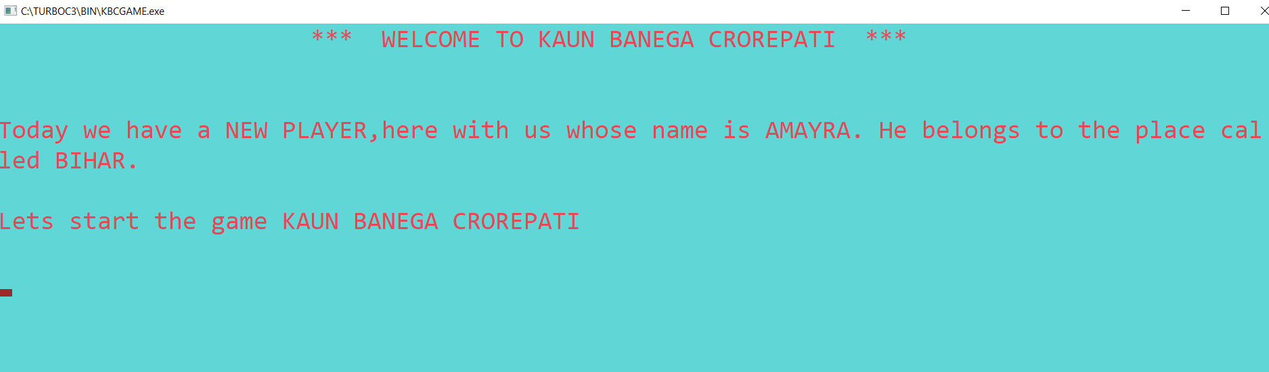

Slide 9
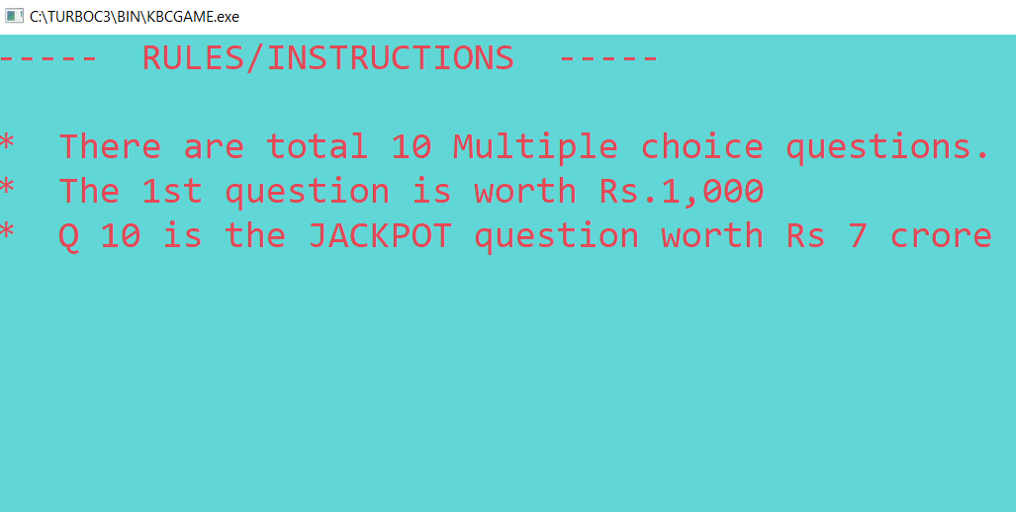
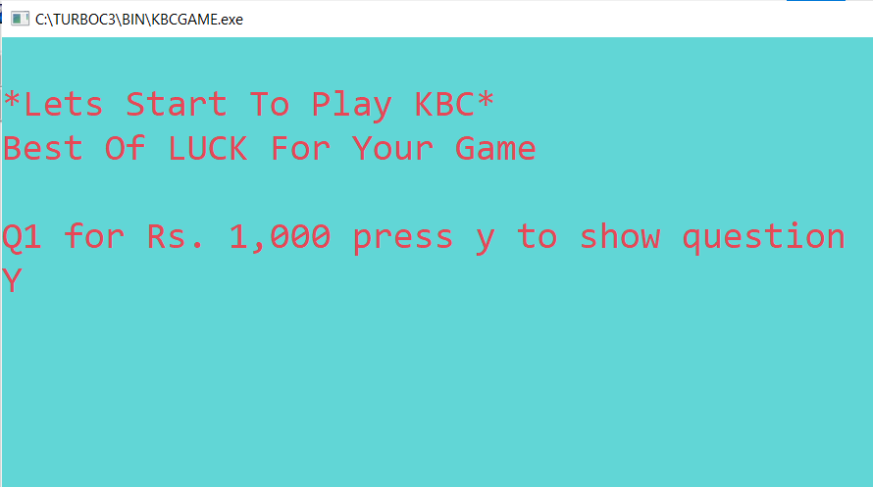

Slide 10
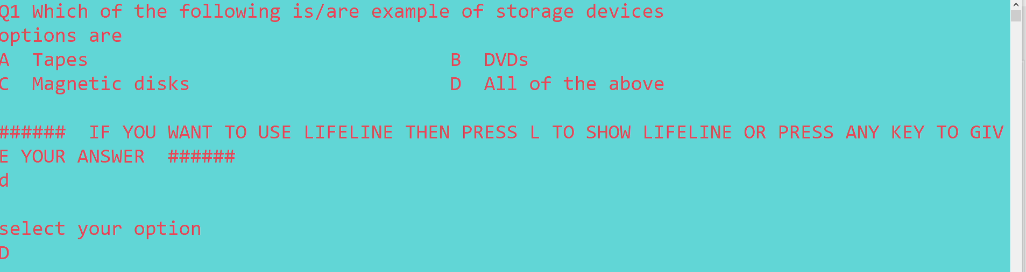
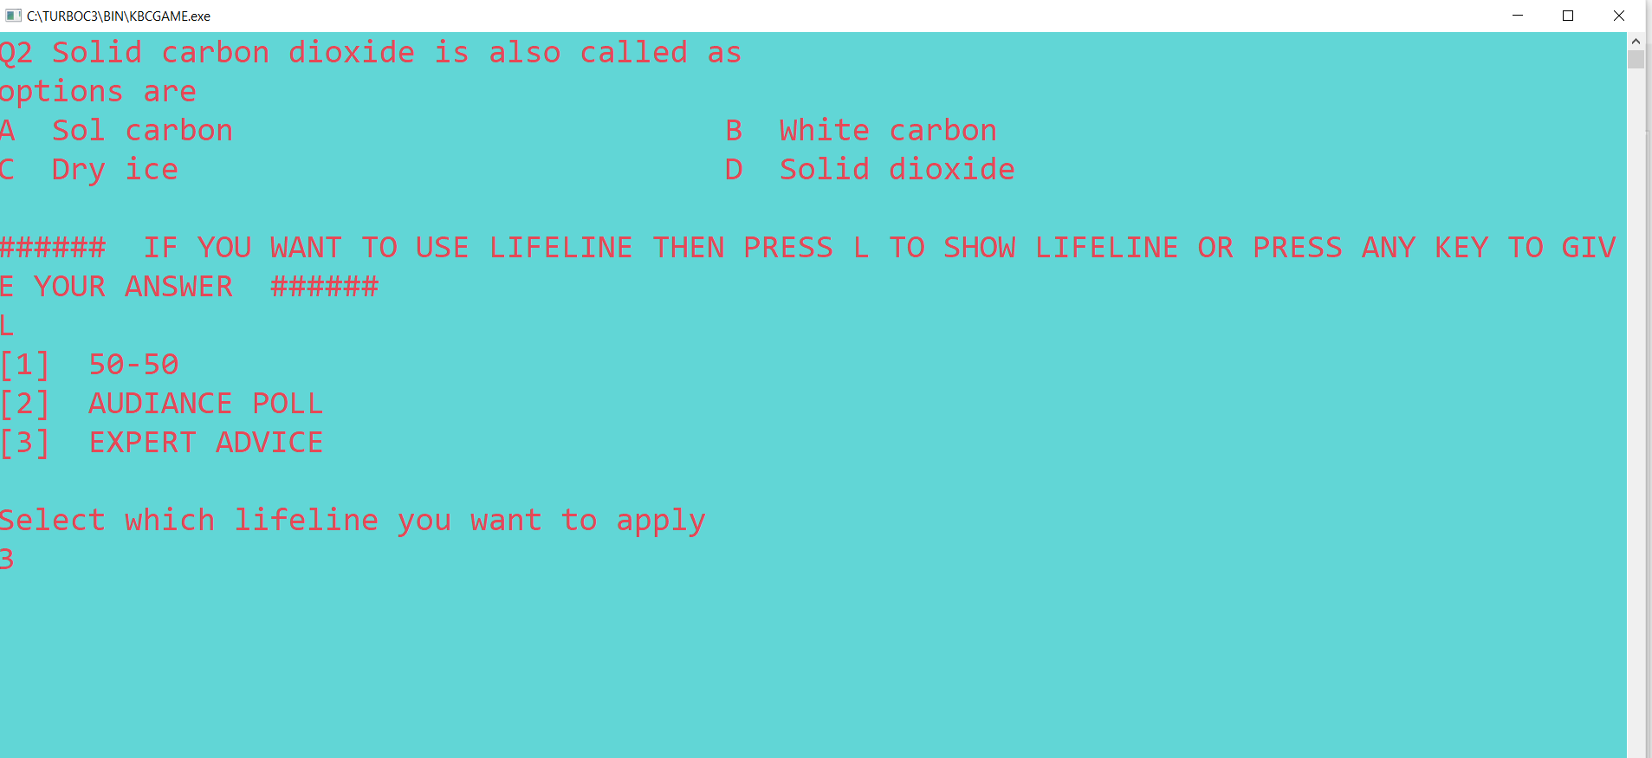

Slide 11
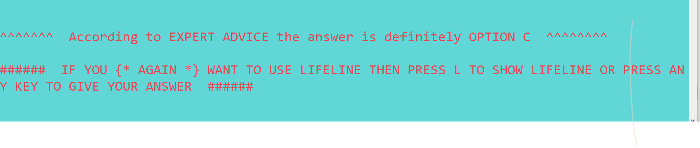
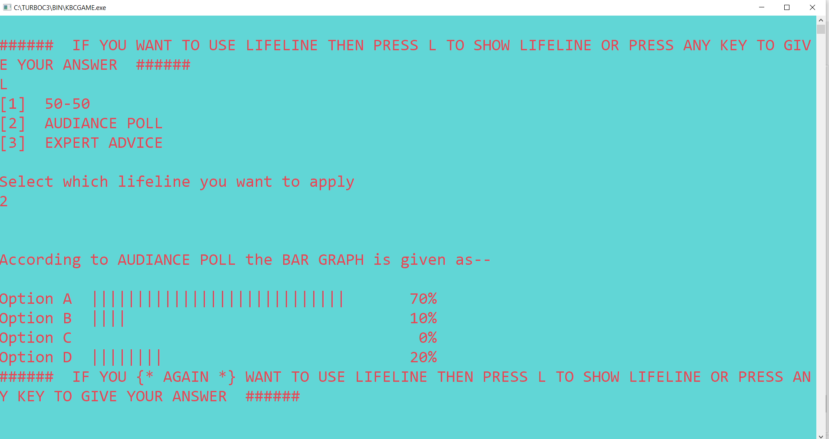

Slide 12
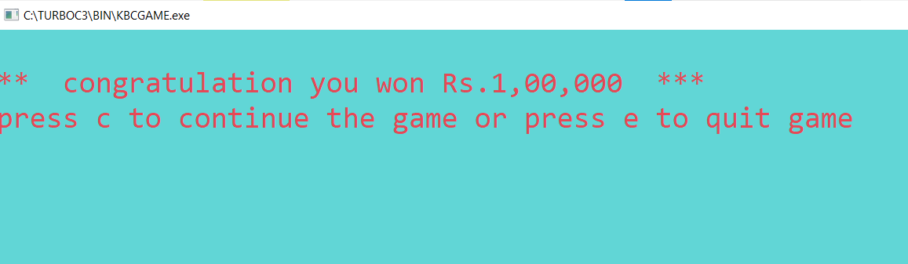
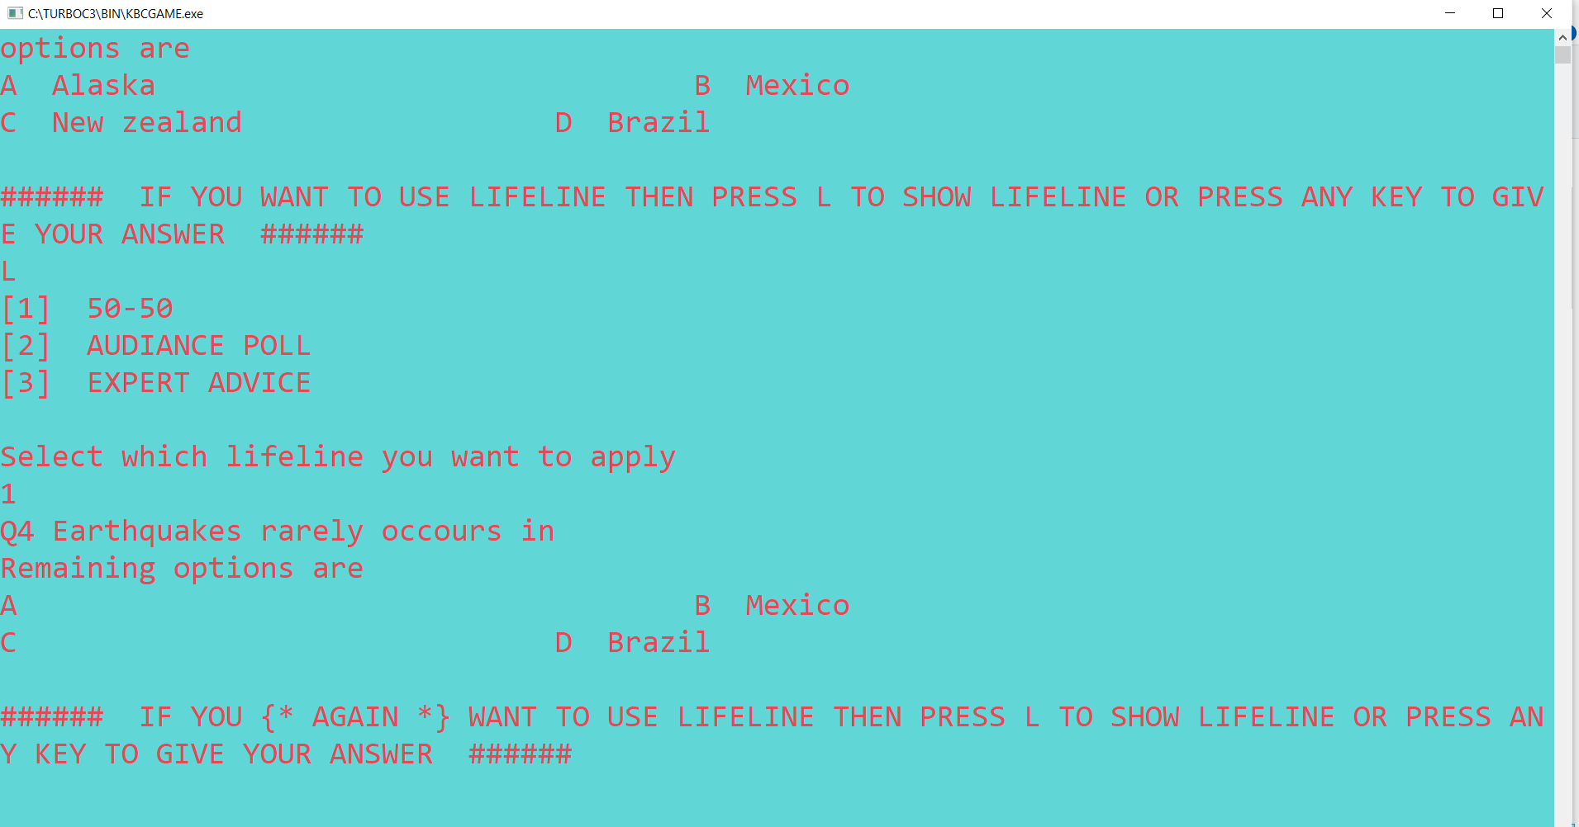

Slide 13
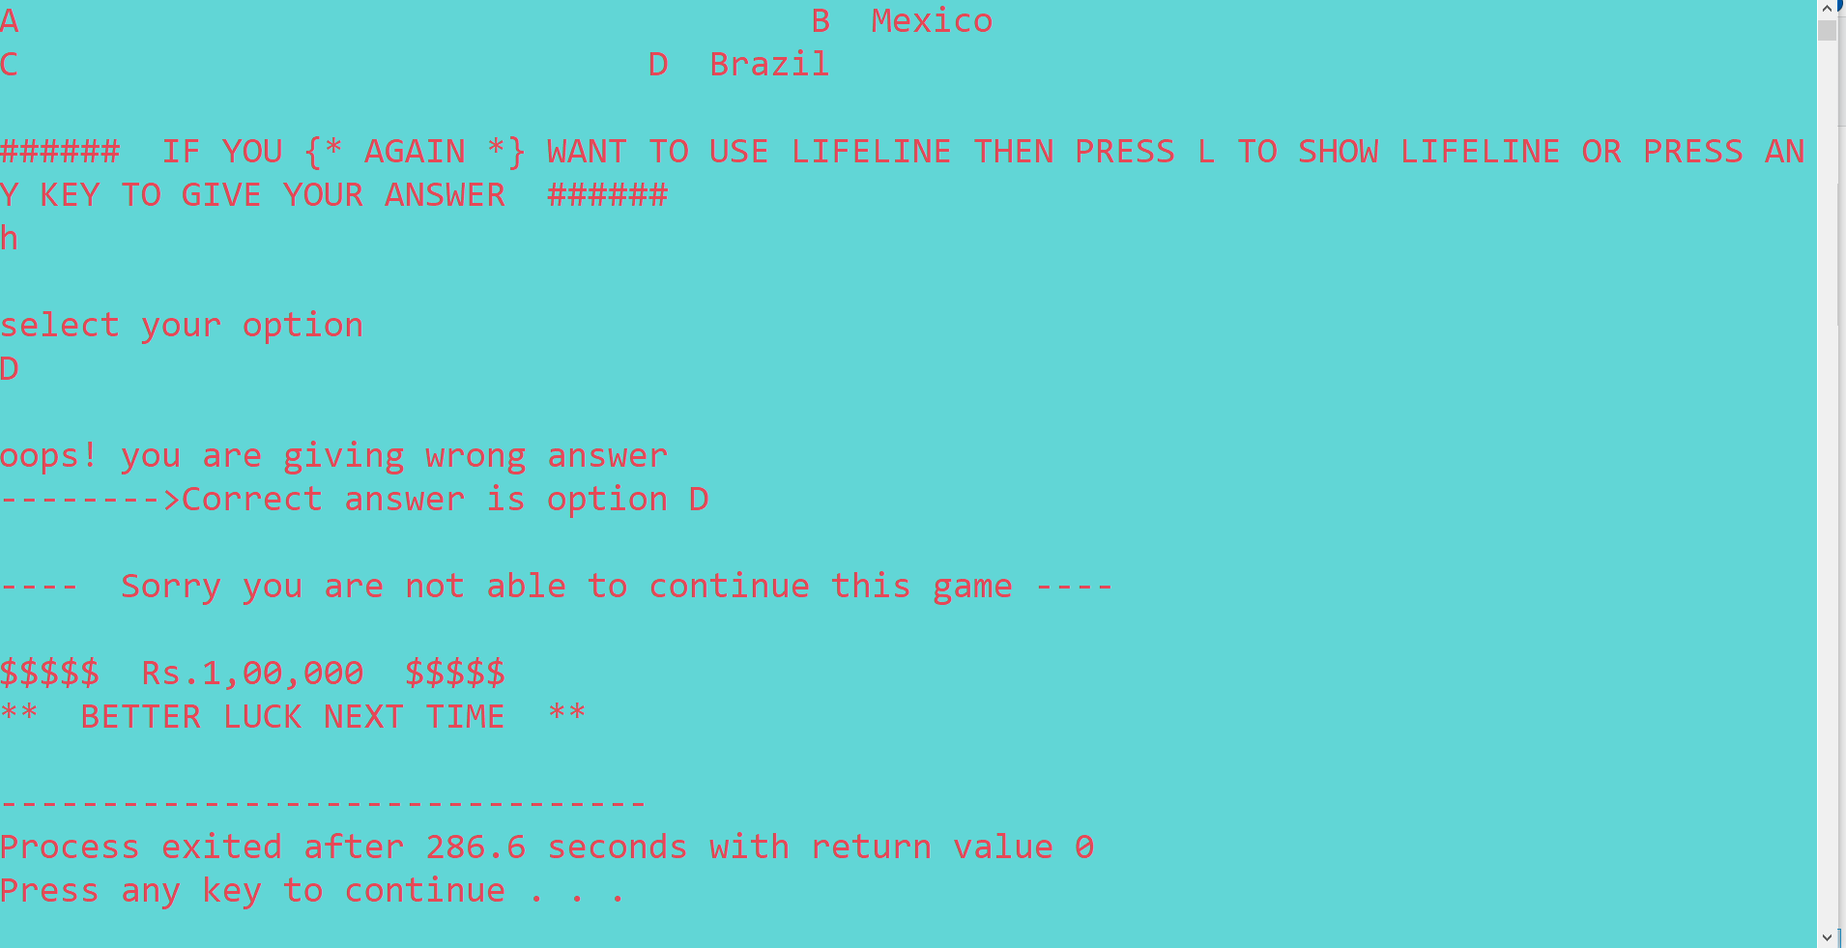

Slide 14
Conclusion
Our project is only a humble venture to satisfy the needs to manage their project. Several user friendly coding has also been adopted. The objectives of software planning is to provide a frame work that enables the manager to make reasonable estimates made within a limited time frame at the beginning of the software projects and should be updated regularly as the project progresses.

Slide 15
Future Scope
We can add Printer in future.
We can give more advance software for KBC Quiz system including facilities, we will host Platform on online servers to make it accessible worldwide.
Integrate multiple load players to distributes the loads of the system.
create the master and slave database structure to reduce the overload of the database queries and implement the backup mechanism for taking backup of codebase and database on regular basis on different servers.

Slide 16
References
https://www.w3schools.com/cpp
https://www.geeksforgeeks.org/c-plus-plus
Google for problem solving.

